Slide 1

Presentation on Vaping Prepared by Public Health Nurses
October 2019
Notes:
Although the decline in cigarette use by teens continues, the emergence of e-cigarette use by teens needs to be monitored.
To facilitate the teaching of this topic in the classroom, this presentation is accompanied by a reference guide for teachers, which provides additional information.

Slide 2

CHOOSE the right path for your HEALTH!
Notes:
It is recommended to start the presentation by assessing the knowledge and viewpoints of students by asking open questions, such as:
“Why do some young people start vaping?”
“What is attractive about it to them?”
Image source: Pexels

Slide 3

What is an
e-cigarette?
History and Marketing
Harmful Effects of Nicotine
Legislation and
Policies
Refusal Strategies
Notes:
The presentation is divided into five modules. At the end of each module, there are knowledge-testing questions, followed by a discussion period.
Module 1
What is an e-cigarette?
Module 2
Harmful Effects of Nicotine
Module 3
History and Marketing
Module 4
Legislation and Policies
Module 5
Refusal Strategies
Image source: Pixabay

Slide 4
Module 1
What is an e-cigarette?

Slide 5

The extent
of the
vaping problem
and the
harmful effects
on health
are alarming.
Notes:
Many people wrongly believe that e-cigarettes are harmless.
https://www.canada.ca/en/services/health/publications/healthy-living/talking-teen-vaping-tip-sheet-parents.html
Important:
The purpose of vaping is to help smokers quit smoking. It is not intended for young people or non-smokers.
https://www.canada.ca/en/health-canada/services/publications/healthy-living/talking-teens-vaping-tip-sheet.html
Image source: Pixabay

Slide 6


Extent of the Problem
23%
29%
Canada
Grade 7-12 students
New Brunswick
Grade 6-12 students
https://www.canada.ca/en/health-canada/services/publications/healthy-living/talking-teens-vaping-tip-sheet.html
https://nbhc.ca/sites/default/files/publications-attachments/SWS18-19%20-New%20Brunswick%20Provincial%20Results.pdf
Notes:
Vaping is not risk-free, but Canadian teens are starting to vape anyway.
According to a recent survey by Health Canada, 23%of Grade 7-12 students have already used e-cigarettes. Moreover, according to the New Brunswick Health Council (2018-2019), 29%of Grade 6-12 students have used e-cigarettes (“vapes”).
Health Canada (2016-2017)
https://www.canada.ca/en/health-canada/services/publications/healthy-living/talking-teens-vaping-tip-sheet.html
https://www.canada.ca/en/health-canada/services/canadian-student-tobacco-alcohol-drugs-survey/2016-2017-summary.html
New Brunswick Health Council (2018-2019)
https://nbhc.ca/sites/default/files/publications-attachments/SWS18-19%20-New%20Brunswick%20Provincial%20Results.pdf
Image source: PowerPoint Clipart

Slide 7
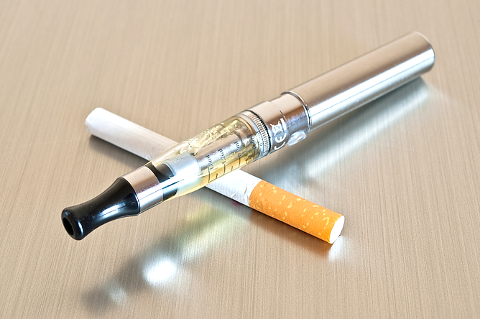
  Smoking or Vaping
  Harmful Effects on Health
Smoking
Tobacco or other substances are burned (combustion)
by inhaling the smoke
through the mouth.
Vaping
The device heats the liquid
(no combustion) and
turns it into vapour,
then into aerosol.
Notes:
https://www.canada.ca/en/health-canada/services/smoking-tobacco/vaping.html
Image source: PowerPoint Clipart

Slide 8
Vaping Devices
Mods
Vapes
Electronic
cigarettes
E-cigarettes
Electronic nicotine delivery systems (ENDS)
« JUUL »
Notes:
Vaping devices are available in many shapes and sizes. Some are small and look like USB drives (e.g., JUUL) or pens, while others are much larger.
There are two types of vaping devices:
open, which means they can be refilled;
closed, which means either the whole product, or the part that holds the vaping substances, cannot be refilled (single –use cartridge).
https://www.canada.ca/en/health-canada/services/smoking-tobacco/vaping.html
Image source: PowerPoint Clipart

Slide 9
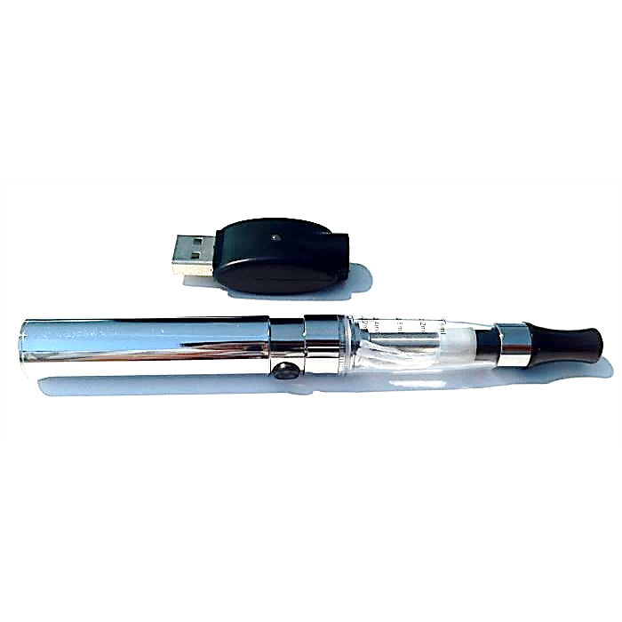
E-Cigarette
Battery
Tank
Heating Element
Mouthpiece
Notes:
The vaping liquid, which contains chemicals, is heated to become an aerosol. The aerosol is inhaled through the mouth and lungs where it is absorbed into the bloodstream. The remaining aerosol is exhaled.
https://www.canada.ca/en/health-canada/services/smoking-tobacco/vaping.html
Image source: PowerPoint Clipart

Slide 10

E-Cigarette
Most vaping substances:
are liquids
are flavoured
contain nicotine
Notes:
In vaping, liquids, nicotine and flavouring compounds are dissolved in a liquid mixture. This mixture is typically propylene glycol and glycerol (vegetable glycerin). They are considered harmless for use in many consumer products such as cosmetics and sweeteners. However, the safety of long-term inhalation of the substances contained in vaping products is still under review.
https://www.canada.ca/en/health-canada/services/smoking-tobacco/vaping.html
https://www.canada.ca/en/health-canada/services/smoking-tobacco/vaping/risks.html
Image source: PowerPoint Clipart

Slide 11
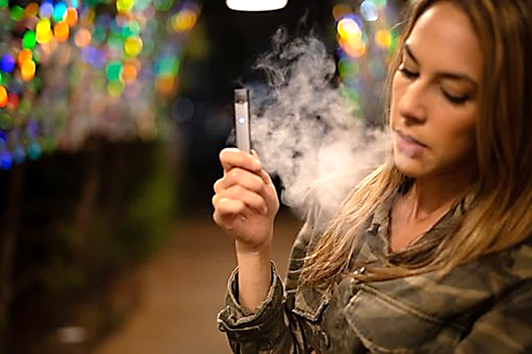
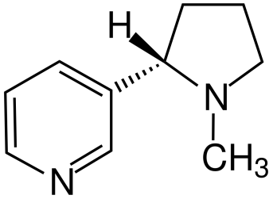
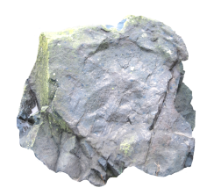
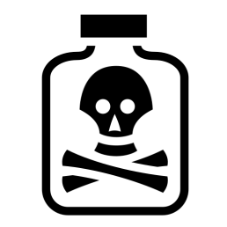

Nicotine
Heavy metals
Chemicals
Diacetyl
Notes:
There are health risks linked to other chemicals found in vaping products.
The vaping process needs the liquid to be heated. This can create new chemicals, such as formaldehyde (a colorless gas found in paints, detergents and glues). Some contaminants (e.g. heavy metals such as nickel, tin and aluminum) might also get into the vaping products and then into the vapour.
https://www.canada.ca/en/health-canada/services/smoking-tobacco/vaping/risks.html
https://www.canada.ca/en/health-canada/services/environmental-workplace-health/formaldehyde-pollutants-household-products-building-materials.html
Diacetyl is a flavouring chemical used to give butter-like and other flavours to food products as well as vaping products.
The chemicals used to flavour vaping products have not been tested for safety when inhaled.
https://www.canada.ca/en/health-canada/services/smoking-tobacco/vaping/risks.html
https://www.cdc.gov/tobacco/infographics/youth/pdfs/e-cigarettes-usb-flash-508.pdf
It is hard to know what is contained in e-cigarette products. For example, it was discovered that some e-cigarettes that claim 0% nicotine still contain it.
https://www.cdc.gov/tobacco/basic_information/e-cigarettes/about-e-cigarettes.html#two
Image sources: Pixabay and PowerPoint Clipart

Slide 12

Nicotine is absorbed through
the lungs.
Then, it moves through the bloodstream
to the brain and all the other organs.
Notes:
https://www.canada.ca/en/health-canada/services/smoking-tobacco/effects-smoking/smoking-your-body/nicotine-addiction.html
Image source: Adobe Stock (purchase)

Slide 13

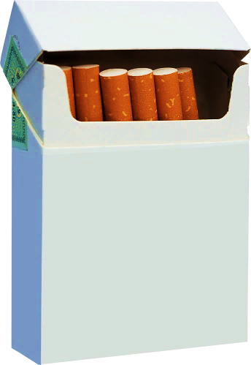
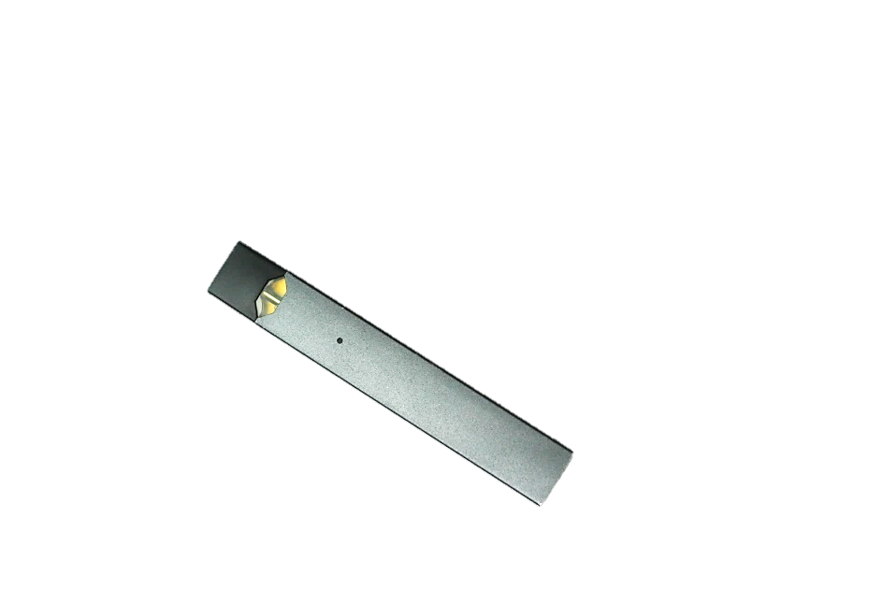
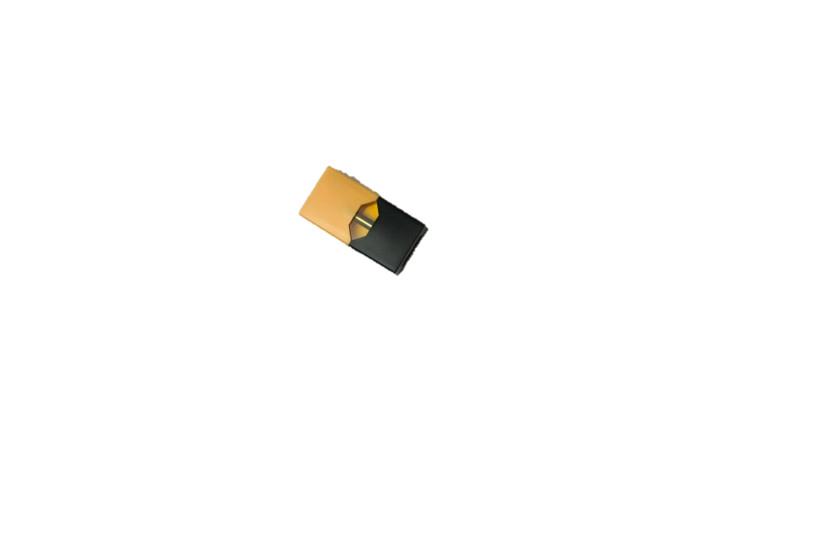
A single JUUL pod contains
as much nicotine as a pack
of 20 regular cigarettes.
=
Notes:
In vaping substances that contain nicotine, the level of nicotine can vary widely.
Some mixtures with very low levels of nicotine can contain more nicotine than a regular cigarette (e.g., the JUUL).
https://www.canada.ca/en/health-canada/services/smoking-tobacco/vaping.html
https://www.cdc.gov/tobacco/infographics/youth/pdfs/e-cigarettes-usb-flash-508.pdf
Image sources: Clipart PowerPoint, Adobe Stock (purchase) and Pixabay

Slide 14
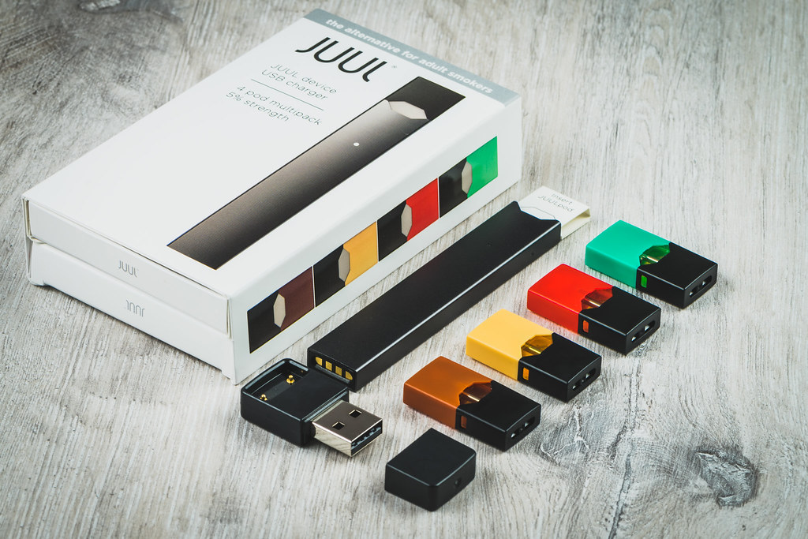
Nicotine Salts
Causes less irritation in the throat, which allows larger amounts of nicotine to be inhaled
DANGER
Inhalation of high concentrations
of nicotine
Notes:
Nicotine salts in JUUL e-cigarettes
Nicotine salt formulations are a relatively recent innovation.
https://www.canada.ca/en/health-canada/programs/consultation-reducing-youth-access-appeal-vaping-products-potential-regulatory-measures/document.html
https://nb.lung.ca/sites/default/files/vaping%20brochure%20eng.pdf
Image source: PowerPoint Clipart

Slide 15
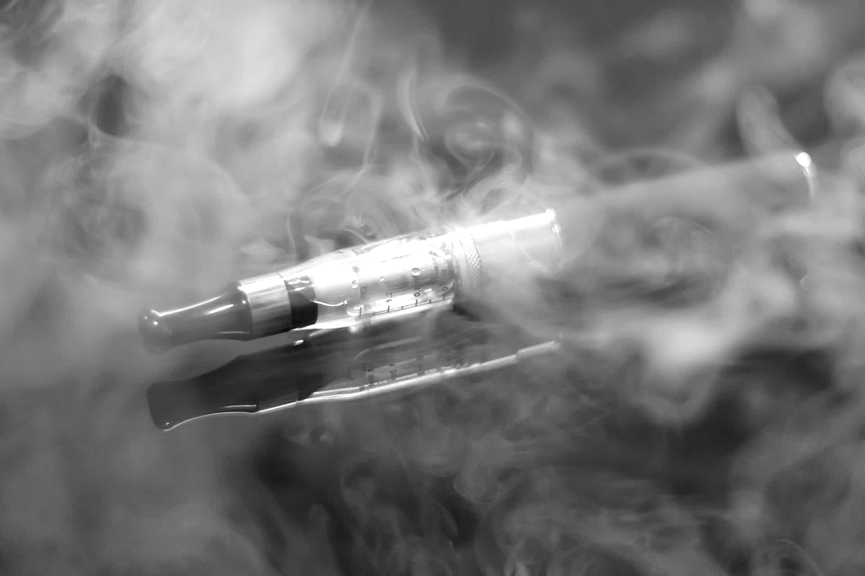
Définition
Warning!
Cannabis
Some e-cigarettes
may contain cannabis!
Notes:
Image source: Pixabay

Slide 16
Test your
Knowledge!

Slide 17

True or false?
E-cigarette use is on the rise
among young people.
True
Notes:
Answer:
True
Vaping is not risk-free, but teens are staring to vape anyway. It is a major issue given the significant rise in teen use in recent years.
https://avoidthetrap.ca/
Image source: Pixabay

Slide 18
True or false?
The addition of flavouring
to e-cigarette liquid
is harmless.
Notes:
Image source: Pixabay

Slide 19
False
The chemicals used to
flavour vaping products
pose health risks.
The liquid used may contain nicotine, regardless of the flavour.
Notes:
Answer:
False
The chemicals used to flavour vaping products pose health risks.
The liquid used may contain nicotine, regardless of the flavour.
https://www.canada.ca/en/health-canada/services/smoking-tobacco/vaping/risks.html
Image source: Pixabay

Slide 20
True or false?
E-cigarettes only produce water vapour.
Notes:
Image source: Pixabay

Slide 21
False
In general, e-cigarettes contain propylene glycol, glycerol, concentrated flavours,
nicotine and many other
chemical compounds.
Notes:
Answer:
False
In general, e-cigarettes contain propylene glycol, glycerol, concentrated flavours and nicotine. There are also many other chemical compounds in the cartridges, in the solution and in the aerosol.
https://avoidthetrap.ca/
Image source: Pixabay

Slide 22
Multiple choice
What chemical substances can be found in vaping products?
  Formaldehyde (colourless gas found in paints, detergents and glues)
  Heavy metals (nickel, tin and aluminum)
  Diacetyl (chemical flavouring)
  All of the above
Notes:
Answer:
d. All of the above
Vaping products contain chemicals that are harmful to your health.
Image source: Pixabay

Slide 23
True or false?
An e-cigarette may contain
more nicotine than
a regular cigarette.
True
Notes:
Answer:
True
For example, in the JUUL, the nicotine content can be equivalent to 20 regular cigarettes. This carries risks, so you need to be careful!
https://www.canada.ca/en/health-canada/services/smoking-tobacco/vaping.html
Image source: Pixabay

Slide 24

Discussion
Notes:
We suggest that you engage in a dialogue on the topics covered in this module and to encourage students to actively participate in group discussions.
Image source: Pixabay

